Slide 1
Queerly Applying to Med School

Slide 2
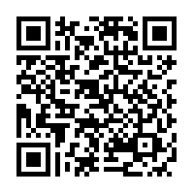
Please complete the first half of the survey.
https://qrgo.page.link/Sc1Dz
Don’t close the window, just minimize and come back at the end to complete the post-survey

Slide 3
“I will leverage the privilege of my position to advocate for social justice, alleviate health disparities, and expand access to healthcare for all.”

Slide 4
Disclosures
We are mostly medical students, we have no finances except for debt. We refuse to charge for this knowledge and encourage others to do the same
We have admission knowledge that is based on our own experiences and the committees at our schools. We do our best to provide comprehensive information but are sharing from our experiences.
We are not presenting as representatives of our medical schools or their admissions committees and therefore will not identify with specific schools for the duration of this webinar.
Notes:
Using Queer for LGBTQQIP2SAA+

Slide 5
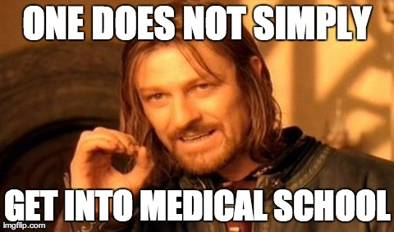
Objectives
Cover general areas that many admissions committees will evaluate you on
Walk through the application packet and some tips for applying
Discuss applying as a queer person with some folxs who did
Have ample time for questions for our panel

Slide 6
What will you be evaluated on?
Leadership
Exposure to Medicine
Research
Service
Academics and Testing
Character

Slide 7
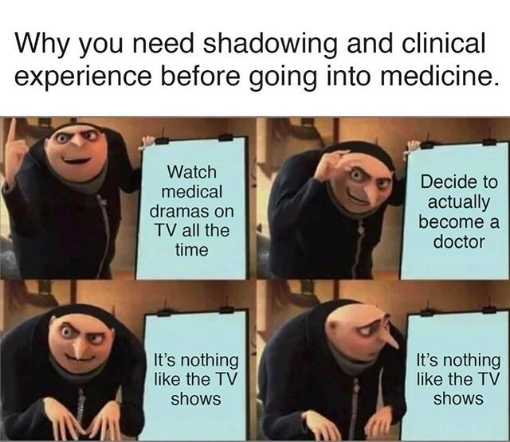
Exposure to Medicine
Why do you want to be a doctor?
What have you done to see if you like medicine?
Shadowing
Paid or Unpaid Medical employment or volunteering

Slide 8
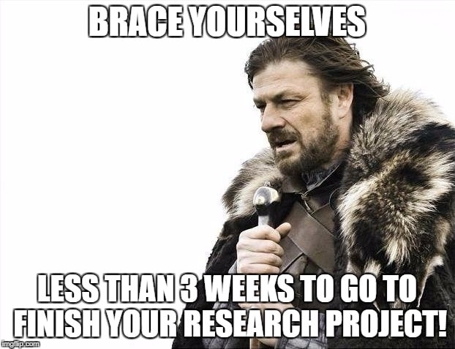
Research
Longitudinal commitments > Short-term projects
Publications are good but not always required
Strong letters of recommendation

Slide 9
Service
Longitudinal commitments > One day experiences
Not just checking boxes, what are you passionate about?
This may be a space where you “out” yourself intentionally or unintentionally
We also understand a need for paid employment over volunteer work

Slide 10
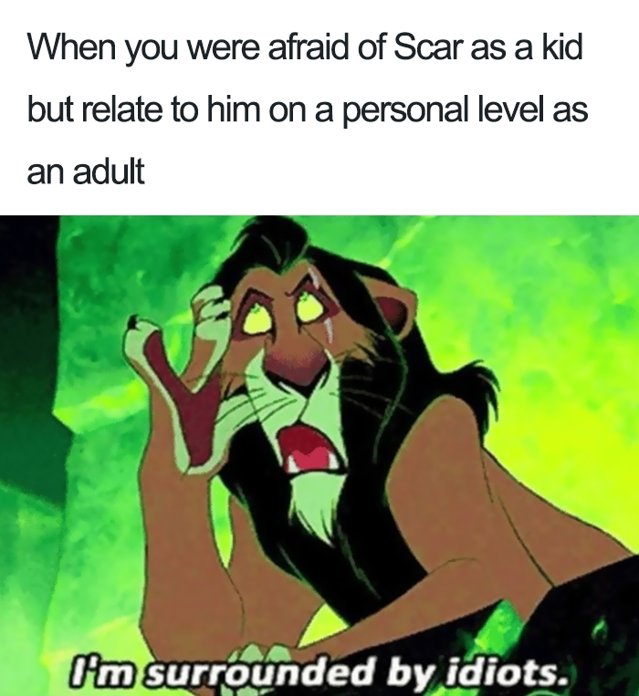
Leadership
Longitudinal commitments > One day experiences
Fits under many categories and can be diverse opportunities
Balance of leadership with humbleness

Slide 11
Academics and Testing
“Cut-offs” vary by school and may or may not be publicized
ALWAYS explain any discrepancies
GPA
An upward trend is good for a lower GPA
Do a masters (or maybe post-bac) if this isn’t so good
MCAT
Above 500 = you will succeed in Med School
But a 500 won’t always cut it
Notes:
GO to MSAR

Slide 12
Character
Letters of recommendation, personal anecdotes
What makes you, you and how does that fit within the vocation of medicine?
Interviews
It’s all in the details and the picture you paint of yourself

Slide 13
The Application Packet

Slide 14
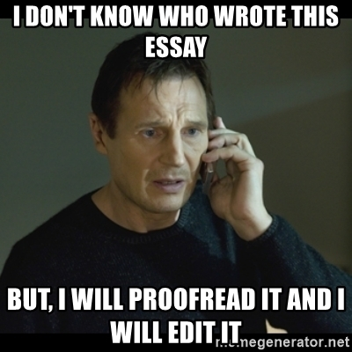
General Principles
Proof Read Everything!
Share with others who will read it and provide critiques
Apply a lot! 15-20 schools is reasonable
Use the MSAR to explore programs

Slide 15
The Cost
$170 for the application and $39 for each school after the first
Unfortunately for 20 schools this = $911
Many schools will have secondary fees of $50-$200
At an average of $100/school this is another $2000
There are fee assistance programs available through the AAMC

Slide 16
Experiences
Hours: get them right- don’t exaggerate, don’t under-sell yourself
You don’t need to fill all 15 slots- don’t get desperate
Only one for hobbies
Don’t stretch to fill
Select the most important ones carefully (consider variety here)
Use the projected hours to your advantage but be reasonable

Slide 17
Personal Statement
Find a way to make this attention grabbing
Do not regurgitate the experiences section or your resume
“Why Medicine” is an important question we want the answer to

Slide 18
Secondaries
ALWAYS describe discrepancies in your application
Never defer blame to someone else
Have a good reason for “why our school”
This is a common space where folxs may out themselves or share more personal details
Panelist: Mollie Marr (she/her)

Slide 19
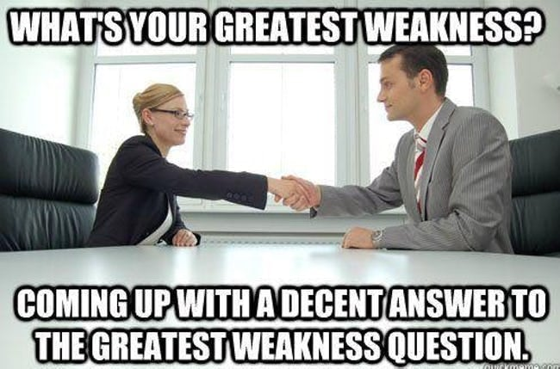
Interview
1:1 “Traditional” Interviews
Sabina Spigner (she/her) Interviewer
Multiple Mini Interview (MMI’s)
Mollie Marr (she/her) Interviewer

Slide 20
This is a lot… how am I going to do it?
Jessica Halem, MBA (she/her)
LGBTQ Outreach and Engagement Director
Harvard Medical School
Jessica_halem@hms.Harvard.edu
Twitter: @jessicahalem

Slide 21
Applying while Queer & Queerstions?
Welcome to our fantastic panel

Slide 22
Panel
Moderator: Tyler Bruinsma (he/him)
Tim Keyes (he/they)
Brad Blansky (he/him)
Mollie Marr (she/her)
Sabina Spigner (she/her)
Demetri Tsiolkas (he/him)
Jessica Halem (she/her)

Slide 23
Please reach out with Questions!
Name | E-mail (@medpride.org) | Twitter
Tyler Bruinsma (he/him) |  | @tjb518
Tim Keyes (he/they) | timothy.keyes | @timothykeyes
Brad Blansky (he/him) | brad.blansky | @darb_isomerase
Mollie Marr (she/her) | mollie.marr | @MollieMarr
Sabina Spigner (she/her) | sabina.spigner | @sabinaspigner
Demetri Tsiolkas (he/him) | demetri.tsiolkas
Jessica Halem (she/her) | jessica_halem@hms.Harvard.edu | @jessicahalem

Slide 24
Special Thanks
To all of our panelists
Joseph Rojo
MSPA Folxs for everything they do

Slide 25
Please complete the post-survey, Thanks!!
Return to the minimized tab from below and submit after completion

